Slide 1

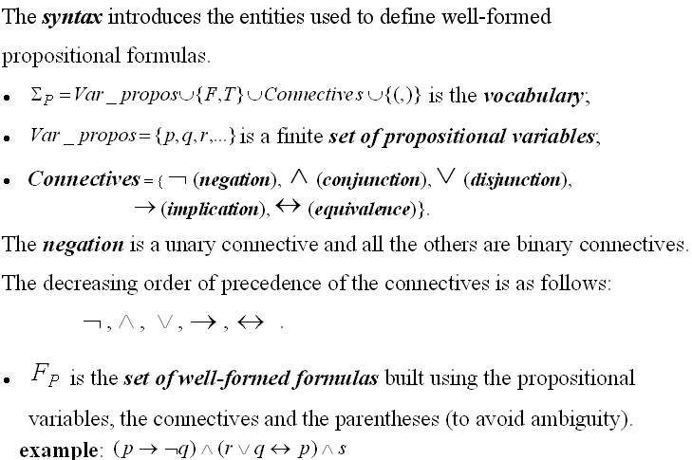
PROPOSITIONAL LOGIC - SYNTAX -

Slide 2
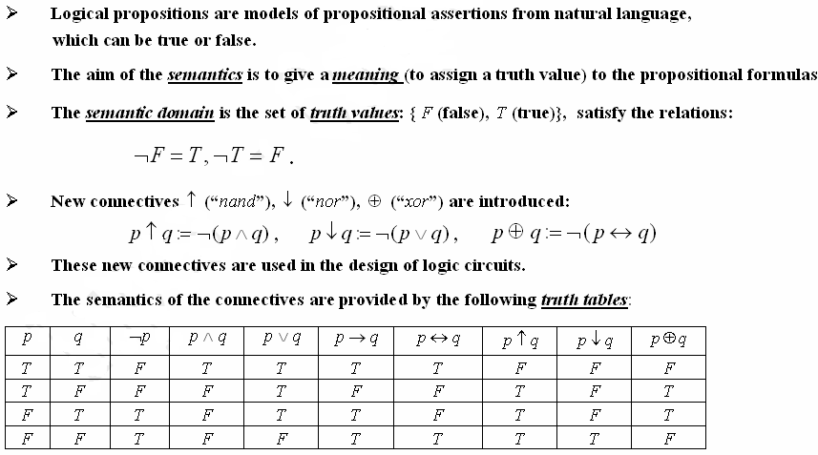
Semantics of propositional logic

Slide 3
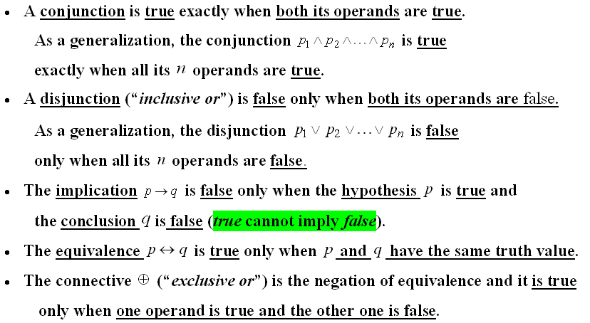
Truth tables

Slide 4




Stylistic variants in English for logical connectives
A and B Both A and B A, but B A, although B A as well as B A, B A, also B | A or B Either A or B A unless B | If A, then B If A, B A is a sufficient condition for B A is sufficient for B In case A, B Provided that A, then B B provided that A B is necessary for A A only if B B if A | A if and only if B A is equivalent to B A is necessary and sufficient for B A just in case B

Slide 5
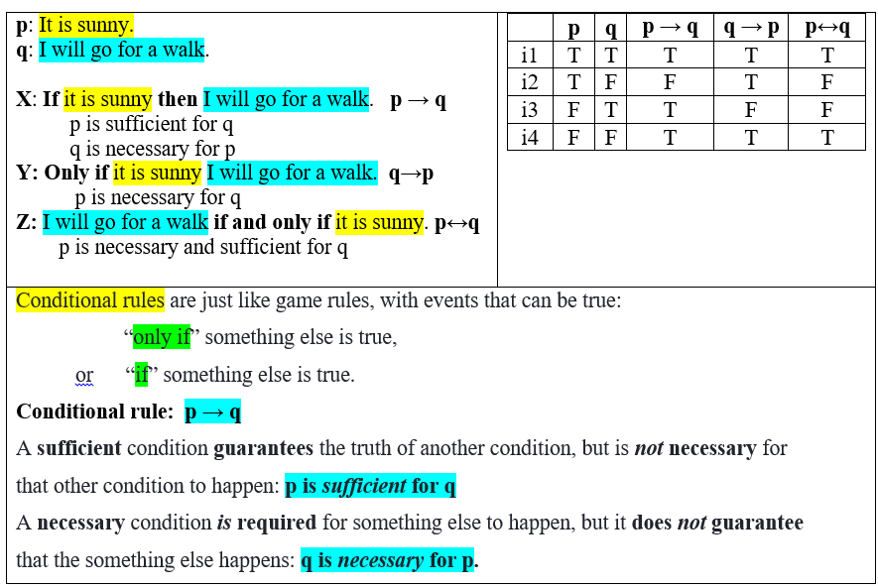
Conditional rules

Slide 6
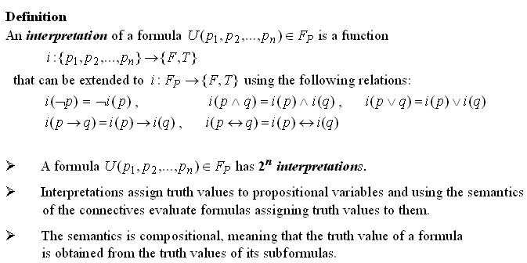
Interpretation of a propositional formula

Slide 7
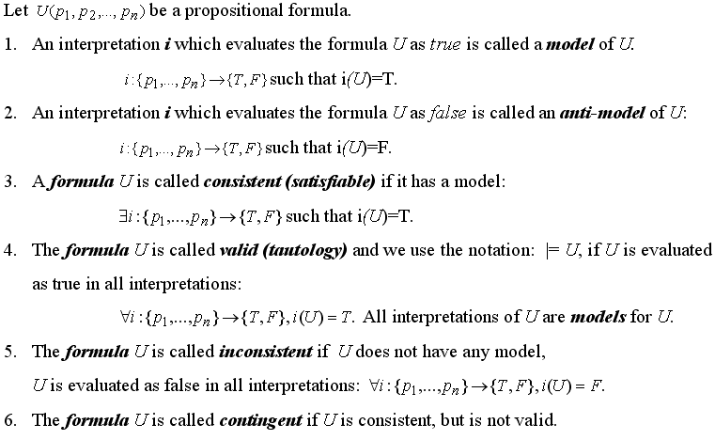
Semantic concepts

Slide 8
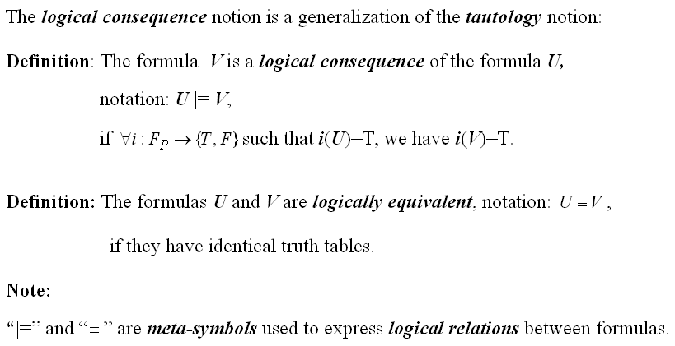
Semantic concepts (contd.)

Slide 9
Problems in propositional logic
Check the validity / consistency / inconsistency property of a propositional formula;
Find the models and anti-models of a consistent formula
Check the logical equivalence and logical consequence relations between two propositional formulas
Check the logical consequence relation between a set of premises (hypotheses) and a conclusion.

Slide 10
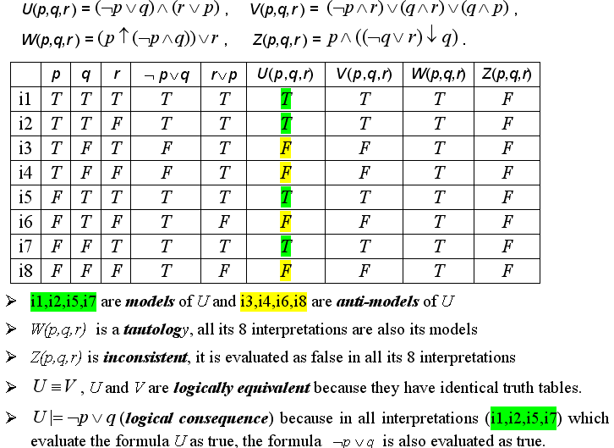
Example 1. Build the truth tables of the formulas:

Slide 11
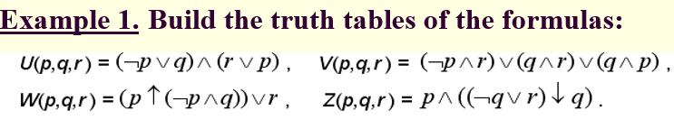
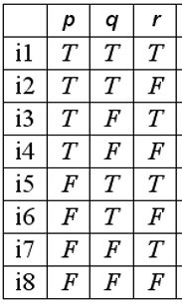


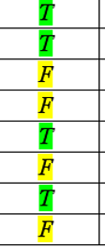
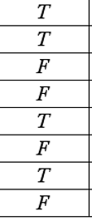
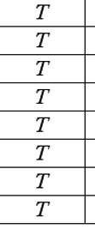

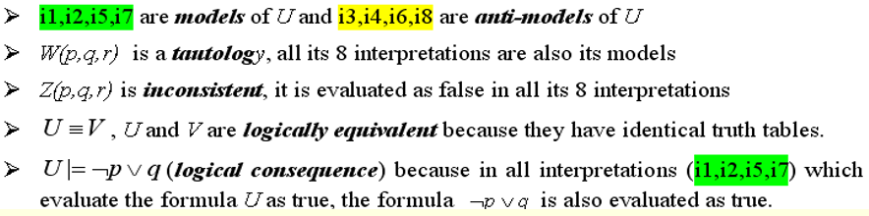

Slide 12
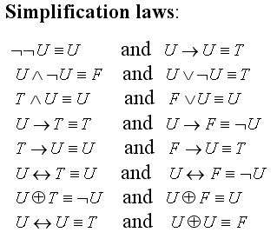
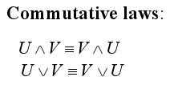
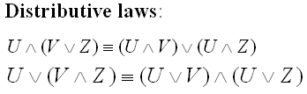
Logical equivalences

Slide 13
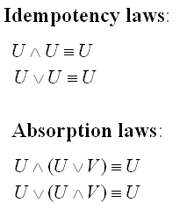
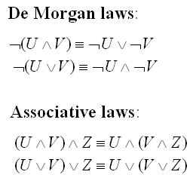
Logical equivalences (contd.)

Slide 14
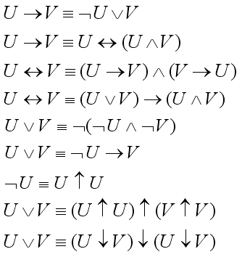
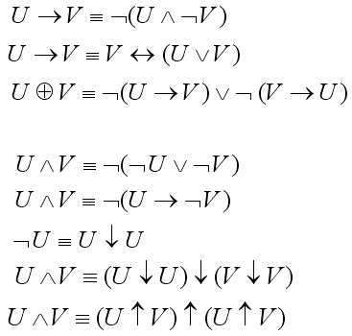
Logical equivalences (contd.) --- Definitions of the connectives ---

Slide 15
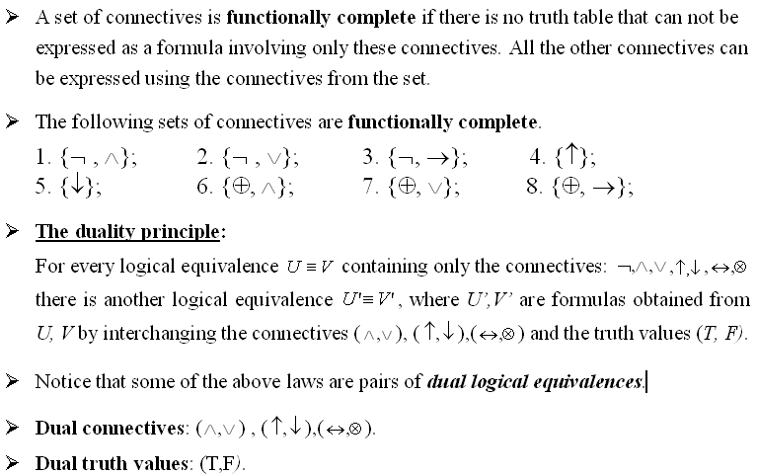

Slide 16
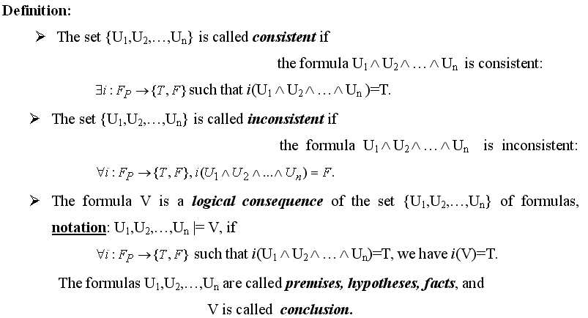
Sets of propositional formulas

Slide 17
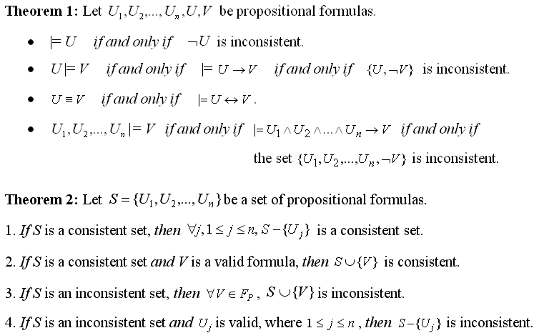
Theorems (semantic results)

Slide 18
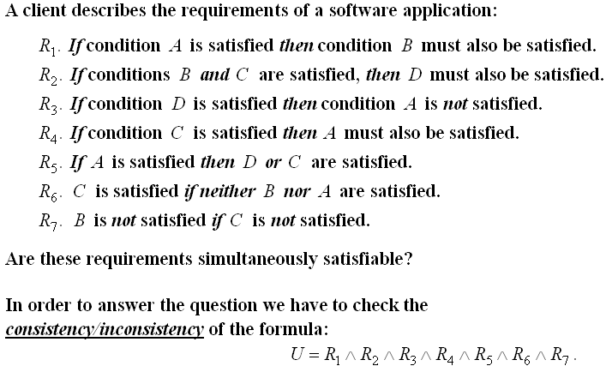
Example

Slide 19
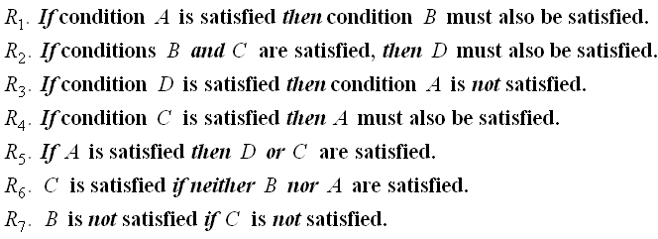
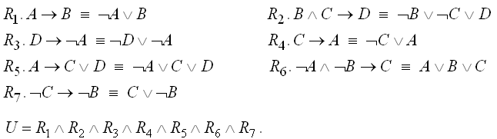
Example (contd.)

Slide 20
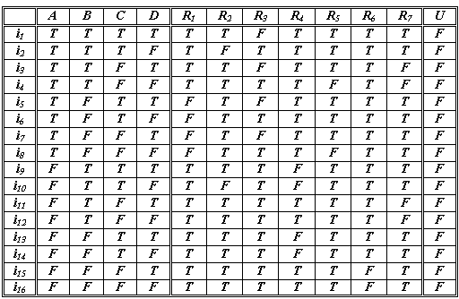
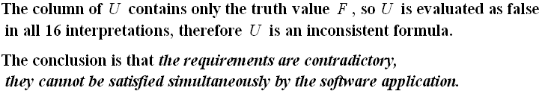
Example (contd.) – Truth table

Slide 21




Normal forms - definitions
A literal is a propositional variable or its negation.
A clause is a disjunction of a finite number of literals.
A cube is a conjunction of a finite number of literals.
A formula is in disjunctive normal form (DNF), if it is written as a disjunction of cubes:
A formula is in conjunctive normal form (CNF), if it is written as a conjunction of clauses:

Slide 22
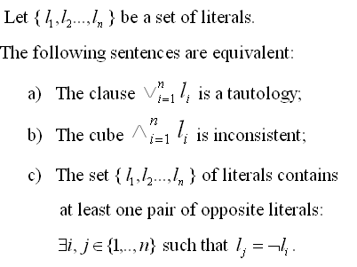
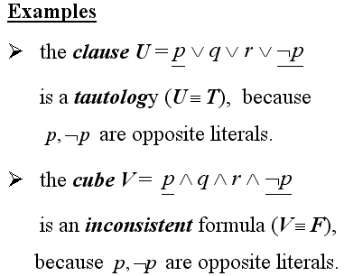
Property

Slide 23
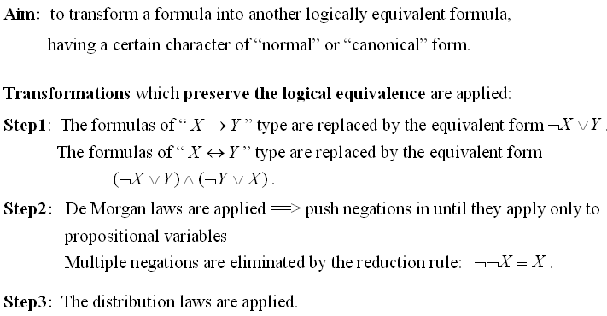
Normalization algorithm

Slide 24
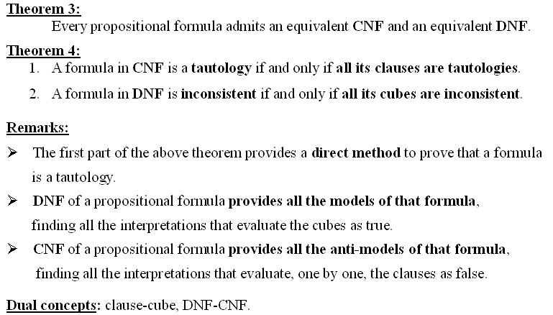
Normal forms – theoretical results

Slide 25

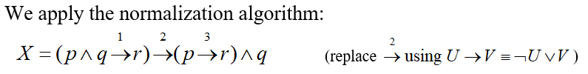

Example

Slide 26

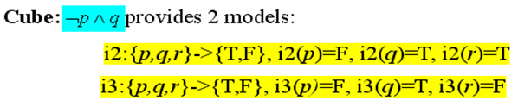
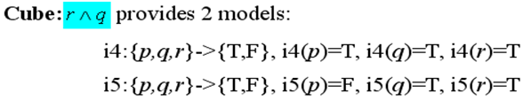
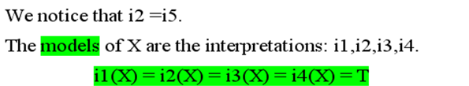

Example – models of a formula

